Slide 1
Web Design with HTML and CSS
Day 2

Slide 2
Adding Links to a Webpage
Hyperlink – It is a link on a webpage that allows users to navigate a website and move from one page to another
Link – It is text, an image, or other webpage content that visitors tap or click to instruct the browser to go to a location in a file
Text link – When text is coded as a hyperlink, it typically appears as underlined text in a color different from the rest of the webpage text
Text link is also known as hypertext link
Image link – It is used to indicate an image as a link and some websites display a border around the image

Slide 3
Anchor element
It is used to create a hyperlink on a webpage
The <a> and </a> are the start and the end tags
Include the href attribute (short for “hypertext reference”) in the starting anchor tag to identify the webpage, email address, file, telephone number, or other content to access
The value of the href attribute is the content for a link

Slide 4
Relative link
It is a hyperlink that links to other webpages within the same website
It is created by using an anchor tag with an href attribute that designates the file name of the webpage or the path and the file name of the webpage
To hyperlink a file from a different folder, specify the folder name in the href attribute value as follows:
<a href=“pages/aboutus.html”>About Us</a>
To go up one folder, put two periods as follows:
<a href=“../pages/aboutus.html”>About Us</a>
Same page links:
<a href=“#bottom”>Scroll down</a>
...
<p id=“bottom”>Last paragraph...</p>

Slide 5
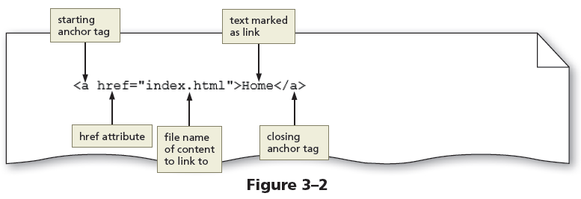
Relative link (continued)
The Figure 3-2 shows an example of a relative link

Slide 6
Absolute link
It is a hyperlink that links to other webpages outside of a website
It is created using an anchor element with an href attribute that designates a website URL

Slide 7
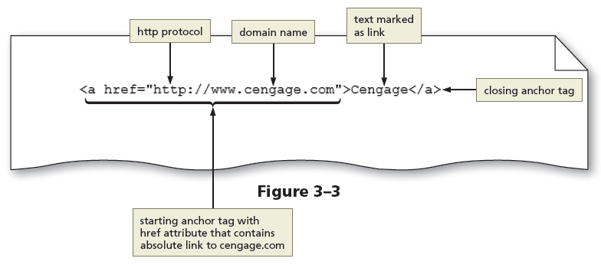
Absolute link
The Figure 3-3 shows an example of an absolute link

Slide 8
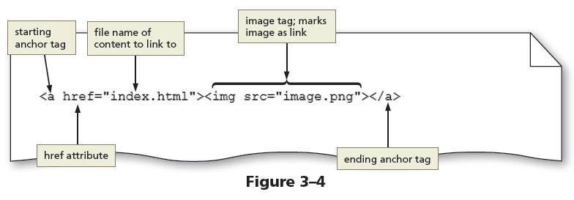
Image link
Images can be used to link to another page within the site, another website, an email address, or a telephone number

Slide 9
Email link
It is a hyperlink that links to an email address
Use anchor elements to link to an email address by including the href attribute followed by "mailto:" and then the email address

Slide 10
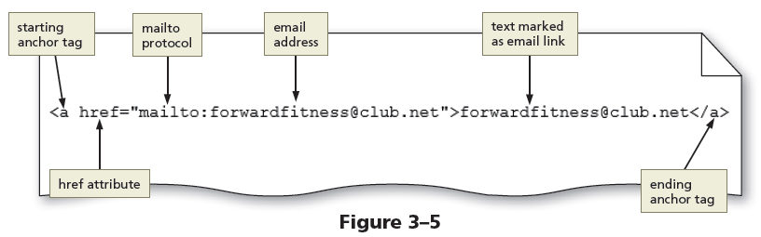
Email link (continued)
The Figure 3-5 shows an example of an email link

Slide 11
Telephone link
It is a hyperlink that links to a telephone number
Use an anchor element to link to a telephone number by including the href attribute, followed by "tel:+1number" where +1 is the international dialing prefix and number is the phone number

Slide 12
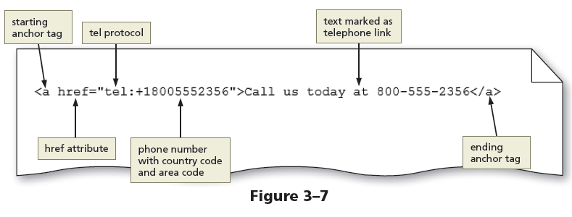
Telephone link
The Figure 3-7 shows an example of a telephone link

Slide 13
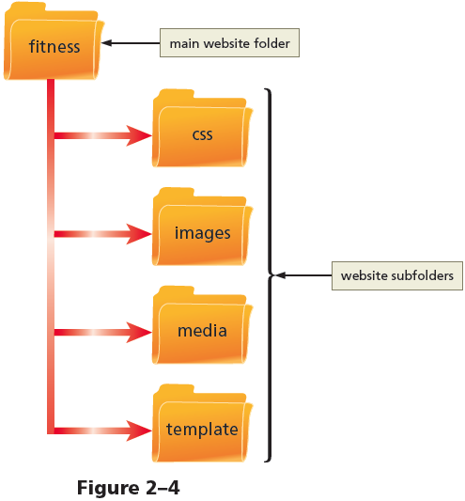
Exercise
Using the web site you started building on day 1, enhance it with hyperlinks.
Use relative links to link web site pages in different folders.
Use absolute links to link from your web site to other Internet websites or web pages.

Slide 14
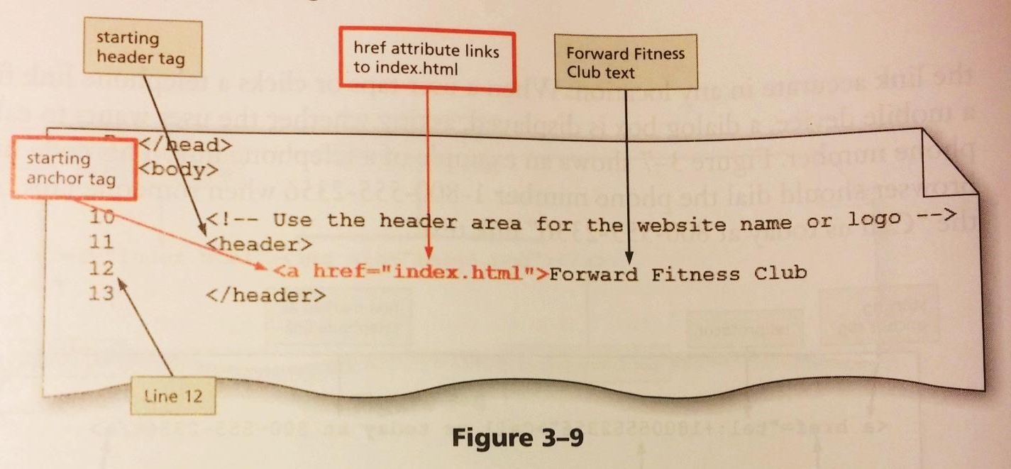
Add Relative Links to Website Template
Open the “fitness.html” file from the Template folder.
Click at the beginning of Line 12 just before our header content, “Forward Fitness Club”
Enter a starting anchor tag that will be a relative link to our home page.

Slide 15
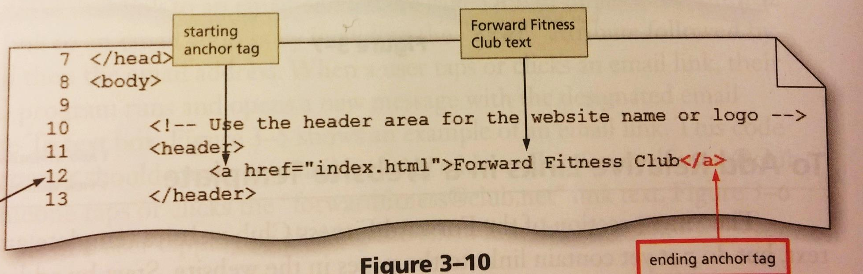
Add Relative Links to Website Template
To complete the link, click at the end of Line 12, after the word “Club”
Enter the closing anchor tag.
Why are we adding a link in the webpage header?

Slide 16
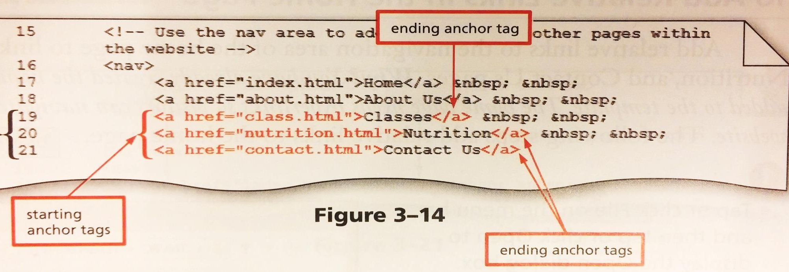
Add Relative Links to Website Template
Now, let’s add links to the elements in the nav area.
Be sure to put the closing anchor tag after the content and NOT after the non-breaking space.

Slide 17
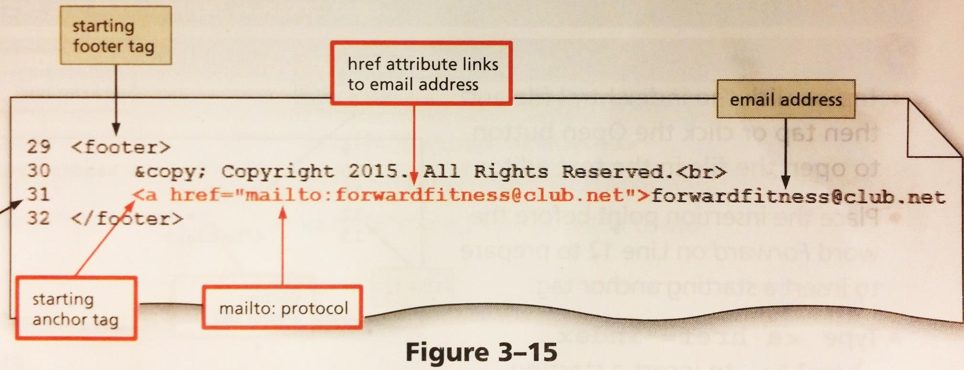
Add an Email Link to Website Template
Click before the e-mail address on Line 31
Enter a starting anchor tag using the “mailto:” protocol
Enter the closing anchor tag after the e-mail address

Slide 18
Exercise
Let’s repeat the last few steps for our Home Page.
Open the “index.html” file from the main Fitness folder.
Add the relative and e-mail links just as we did for the template.
Do we normally repeat steps like this when building a webpage?

Slide 19
Adding Images to a Website
Images include photos, drawings, diagrams, charts, and other graphics that convey visual information
Images should support the purpose of the webpage or illustrate the content

Slide 20
Image File Formats
Image files are created in several formats such as:
Graphics Interchange Format (GIF) – It supports transparency and frame animation
Lossless compression – To compress an image, GIF uses this technique to maintain the file’s color information
Portable Network Graphics (PNG) – It supports transparency, but not animation

Slide 21
Image File Formats
Joint Photographic Experts Group (JPG or JPEG) – It is a standard file format for digital photos
Lossy compression – To reduce file size, this technique is used to discard some of the color information in the image
Scalable Vector Graphics (SVG) – It is a format that uses markup language to create two-dimensional graphics, images, and animations

Slide 22
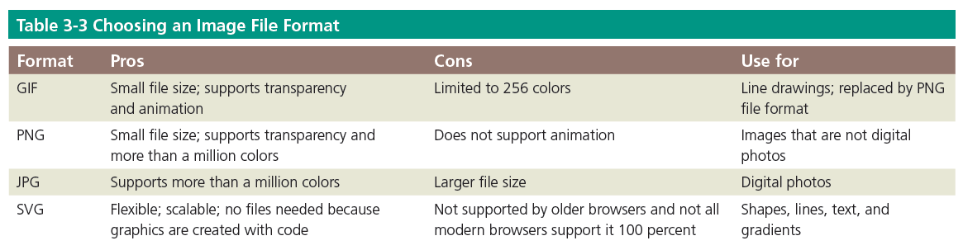
Image File Formats

Slide 23
Image Dimensions and File Size
Pixel – It is the smallest element of light or color on a device displaying images
The common resolution for laptops is 1366 x 768 pixels
The disadvantage of an image with a high resolution is that it also has a large file size
Use graphic or photo editors to optimize an image with a large file size to reduce its file size and load time

Slide 24
Image Tag and Its Attributes
<img> – The image tag is an empty HTML tag used to add an image to a webpage
The image tag includes attributes such as:
src – It identifies the image file being inserted
alt – It specifies alternate text in case the image cannot be displayed in a browser
height – It defines the height of an image in pixels
width – It defines the width of an image in pixels

Slide 25
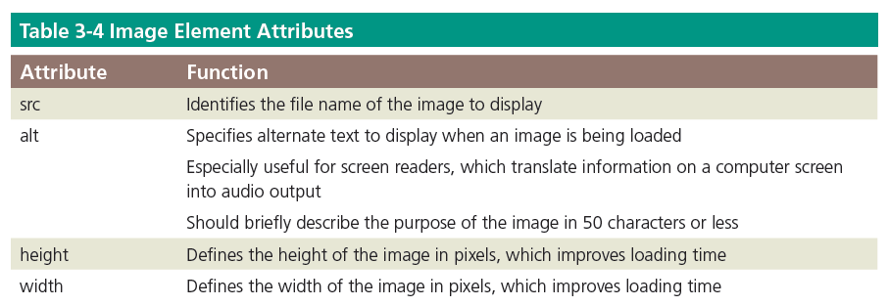
Image Tag and Its Attributes

Slide 26
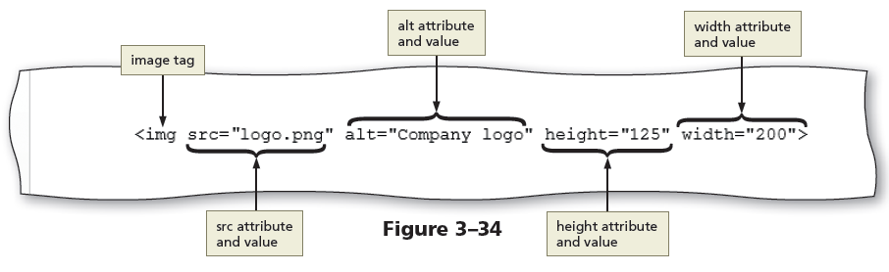
Image Tag and Its Attributes
The Figure 3-34 shows an example of an image tag with attributes

Slide 27
Exercise
Let’s take the template file “fitness.html” and enhance it with images.
Use relative links to add image files from different folders of your site.
Use absolute links to add images from other Internet websites.

Slide 28

Exercise
Copy and paste data files needed for the images into one of our project folders.
Go into the WA110_data_files folder.
Go into the Chapter 3 > Fitness> Images folder and copy the 4 image files.
Navigate to your “fitness” project folder and then into the “images” sub-folder and paste the 4 files.

Slide 29
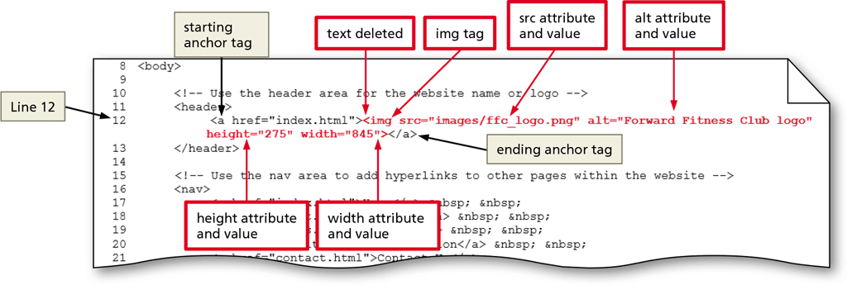
Add an Image to a Website Template
Make sure you have the “fitness.html” file open in Notepad ++.
On line 12, delete the text “Forward Fitness Club” (leave the anchor tags, the image will actually also be a link to the home page).
Enter the image tag, attributes and values.
Notes:
Viewing the template file in the browser will not show the image. This is because the path to the image is set from the root directory, not the sub-directory that the template file resides in.

Slide 30
Do the Same For the Home Page
Switch back to the “index.html” file in the root directory.
Do the same on Line 12 as in the template file.
Again, we normally would not give ourselves twice the work in a real-world scenario.

Slide 31
Div element
Div element defines an area or a division in a webpage
It uses the <div> and </div> tags.
It can be used within the main element to further divide the primary content area into separate sections.

Slide 32
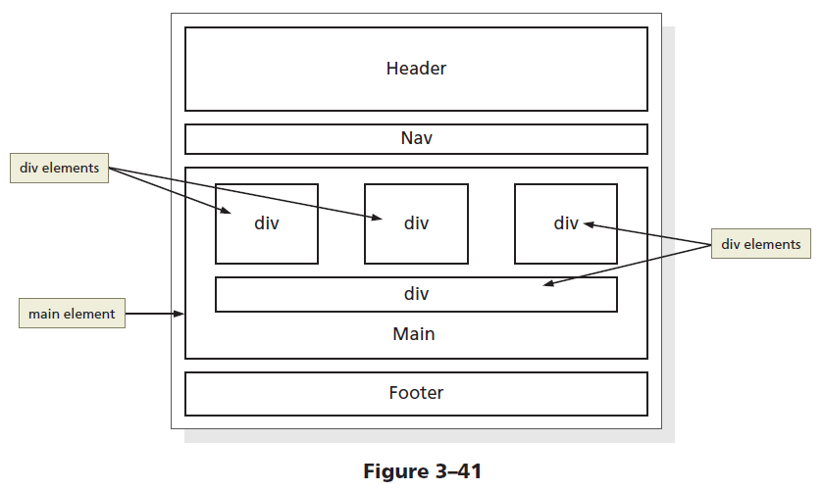
Div element
The Figure 3-41 shows a wireframe with four div elements inside the main element

Slide 33
Div attributes
Div elements have attributes that provide information about the element
The id is a div attribute which identifies a unique area on a webpage and distinguishes it from other page divisions.

Slide 34
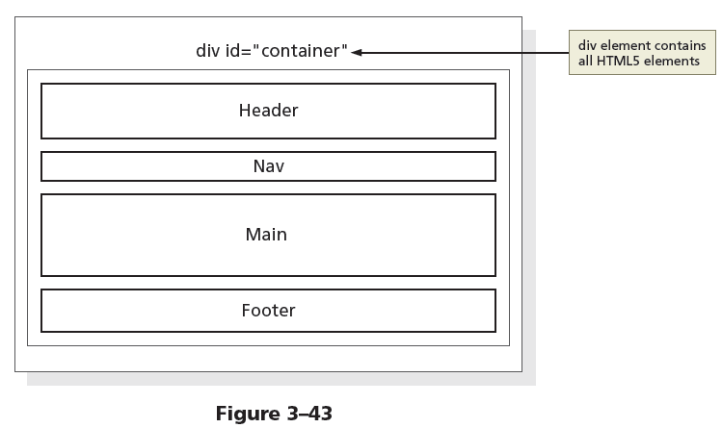
Div attributes
The Figure 3-43 shows the revised wireframe with the div element and id attribute value defined as container

Slide 35
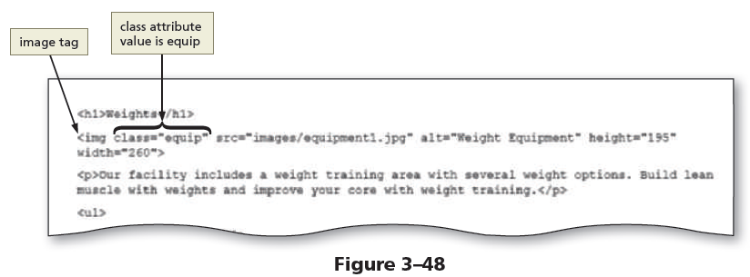
Class Attributes
A class attribute name can be applied to more than one div or other HTML element on a webpage
The Figure 3-48 shows an example of a class attribute used within an image tag

Slide 36
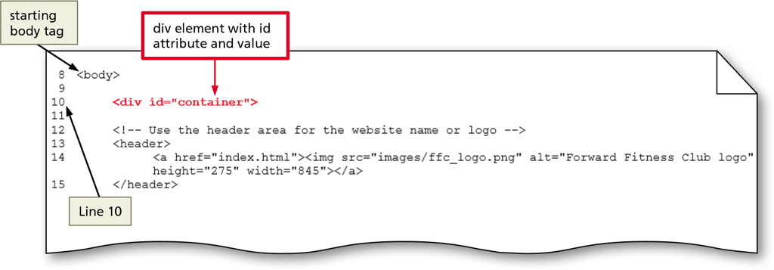
Add a Div Element to the Website Template
Using the “fitness.html” file, we will add a DIV element.
Click after the starting <body> tag and press ENTER twice to create a new line 10
Press TAB to indent the line before entering the code

Slide 37
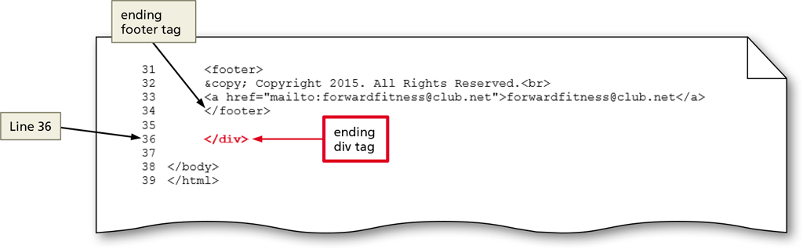
Add a Div Element to the Website Template
Click after the existing ending tag for </footer> and press ENTER two times to create a new line 36.
(If necessary, press TAB to indent)
Type the ending tag to close the DIV element.

Slide 38
Add a Div Element to the Home Page
Again, we will do the same to the “index.html” file.
Be sure to indent the DIV within the <body> element for proper readability.

Slide 39
Adding Headings and Lists
Heading elements – They provide a title or heading before a paragraph of text or section of a page
Heading levels – There are 6 levels of headings, with level 1 being the most important and level 6 the least
<h1>Top Level Heading</h1>
<h2>Other Level Heading</h2>
<h3>Other Level Heading</h3>
...
<h6>Bottom Level Heading<h6>

Slide 40
Adding Headings and Lists
List – It structures text into an itemized format
The different types of lists are:
Unordered list
It displays each item of information in no specific sequence
The <ul> and </ul> are the start and end tags for an unordered list
<li> and </li> are the start and end list item tags
The following code creates a bulleted list of two items:
<ul>
<li>First item</li>
<li>Second item</li>
</ul>

Slide 41
Adding Headings and Lists
Ordered list
It displays information in a series using numbers or letters
The <ol> and </ol> are the start and end tags for an ordered list
<li> and </li> are the start and end list item tags
The following code creates a numbered list of two items:
<ol>
<li>First item</li>
<li>Second item</li>
</ol>

Slide 42
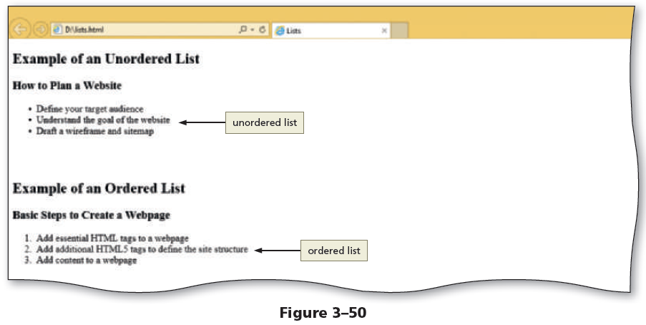
Adding Headings and Lists
The Figure 3-50 shows a webpage with an unordered and an ordered list

Slide 43
Adding Headings and Lists
A description list contains terms and descriptions
The <dl> and </dl> are the start and end tags for a description list
Each term is marked within a pair of <dt> and </dt> tags
Each description or definition is marked between a pair of <dd> and </dd> tags

Slide 44
Adding Headings and List
The following code creates a description list of two terms and definitions:
<dl>
<dt>First term</dt>
<dd>First definition</dd>
<dt>Second term</dt>
<dd>Second definition – part 1</dd>
<dd>Second definition – part 2</dd>
</dl>

Slide 45
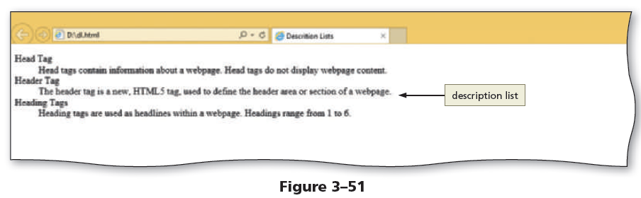
Adding Headings and Lists
The Figure 3-51 shows an example of a description list

Slide 46
Create the ‘About Us’ Webpage
Open the “fitness.html” template file. We will be creating the new webpage using this template.
Click FILE and then SAVE AS from the menu bar.
Navigate up one level so that we are in the root “Fitness” folder (we don’t want to be in the “template” folder).
Type “about” in the file name box and make sure it is saving as type: HTML. Then click the SAVE button.

Slide 47
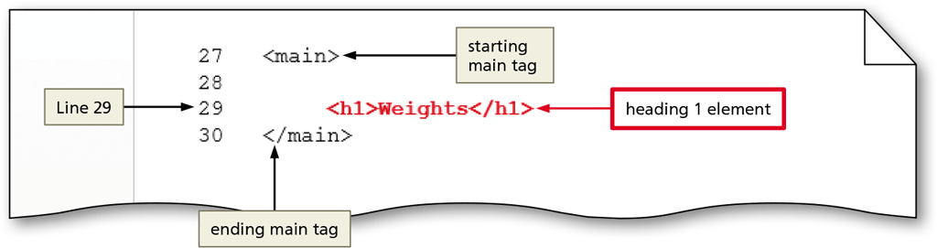
Create the ‘About Us’ Webpage
Place your insertion point after the starting <main> tag on Line 27 and press ENTER twice.
Add the heading 1 tags and content as shown below on Line 29.

Slide 48
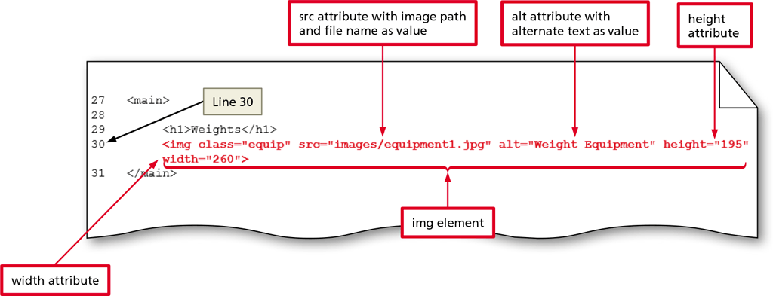
Create the ‘About Us’ Webpage
Press ENTER to add a new Line 30
Add the image element shown below

Slide 49
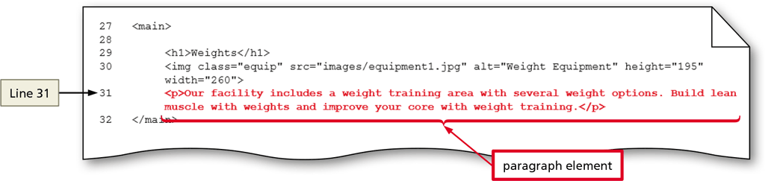
Create the ‘About Us’ Webpage
Press ENTER to add a new Line 31
Add the paragraph element and content shown below

Slide 50
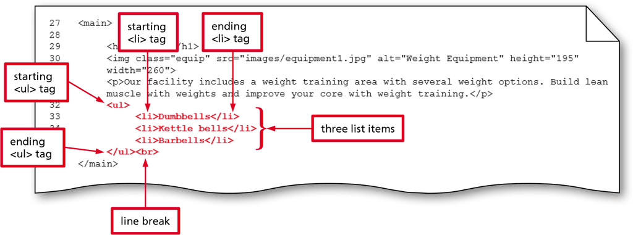
Add Unordered Lists to the About Us Webpage
Press ENTER to add a new Line 32
Type <ul> to insert a starting unordered list tag

Slide 51
Add Unordered Lists to the About Us Webpage
Press ENTER to go to Line 33 and then press TAB to indent (list items are within the unordered list element)
Type <li> for a starting list item tag. Type the content and then type </li> to close the tag. Repeat this 2 more times.

Slide 52
Add Unordered Lists to the About Us Webpage
After the closing tag for “Barbells”, press ENTER and then BACKSPACE to remove your indent.
Add an ending tag for the unordered list element and then type <br> to add a line break.

Slide 53
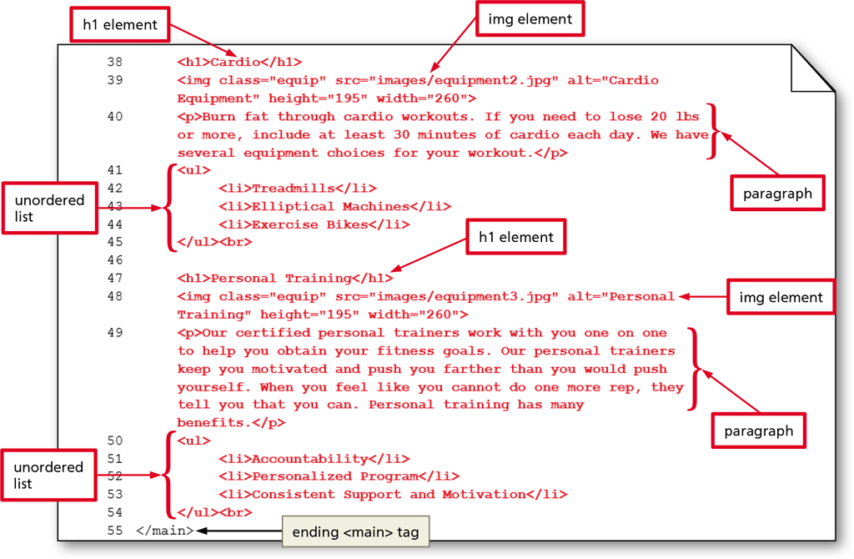
Add Unordered Lists to the About Us Webpage
Press ENTER twice to insert new lines 37 and 38
Add additional elements for headings, images and unordered lists

Slide 54
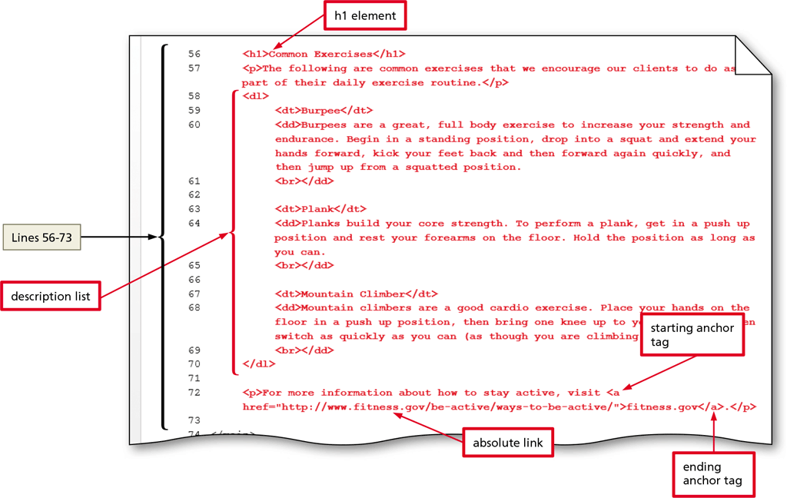
Add a Description List and Absolute Link to the About Us Webpage
With the insertion point at the end of Line 54, press ENTER twice to add lines 55 and 56
We will now be adding more headings, paragraphs, a description list and an absolute link to the website fitness.gov at the end.
Note: If the individual description elements do not appear in the browser with a blank line between them, try reversing the description definition </dd> and the <br> tags.

Slide 55
Save the Webpage and View It in a Browser
Be sure to save the file in Notepad ++
Go to Google Chrome and press “CTRL + O”
Navigate to your Fitness folder (if needed) and open the “about.html” file.
Notice how your “Home” and “About Us” links should now work correctly. Also, the main logo was created as an image link as well, test that out too!

Slide 56
Create the Contact Us Webpage
Reopen the “fitness.html” template file.
Click FILE and then SAVE AS from the menu bar.
Navigate up one level so that we are in the root “Fitness” folder (we don’t want to be in the “template” folder).
Type “contact” in the file name box and make sure it is saving as type: HTML. Then click the SAVE button.

Slide 57
Create the Contact Us Webpage
Reopen the “fitness.html” template file.
Click FILE and then SAVE AS from the menu bar.
Navigate up one level so that we are in the root “Fitness” folder (we don’t want to be in the “template” folder).
Type “contact” in the file name box and make sure it is saving as type: HTML. Then click the SAVE button.

Slide 58
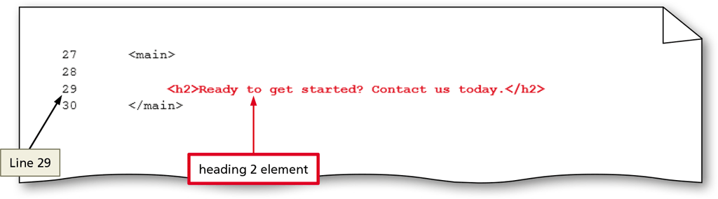
Add a Heading and Links
Place your insertion point after the starting <main> tag and press ENTER twice to insert new lines 28 and 29.
On line 29, increase the indent with TAB and then add a heading 2 element to the page.

Slide 59
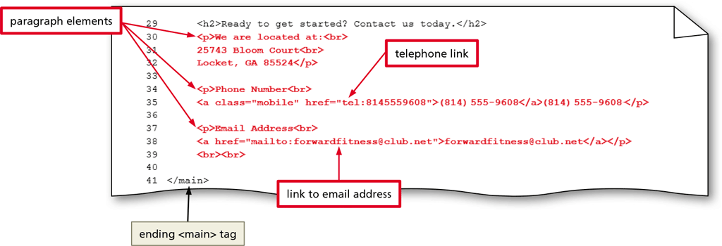
Add a Heading and Links
Press ENTER to insert a new Line 30.
Type the code shown below to add paragraphs and link text.

Slide 60
To Validate Webpages
Perform the following steps to validate an HTML document:
Open a browser and type http://validator.w3.org in the address bar to display the W3C validator page
Tap or click the Validate by File Upload tab to display the Validate by File Upload tab information
Tap or click the Check button to send the document through the validator and display the validation results
Correct the errors if any, save the changes, and run the file through the validator again to revalidate the page
Perform the above steps to validate HTML pages and correct any errors
Close the browser, and then close the HTML text editor

